Slide 1
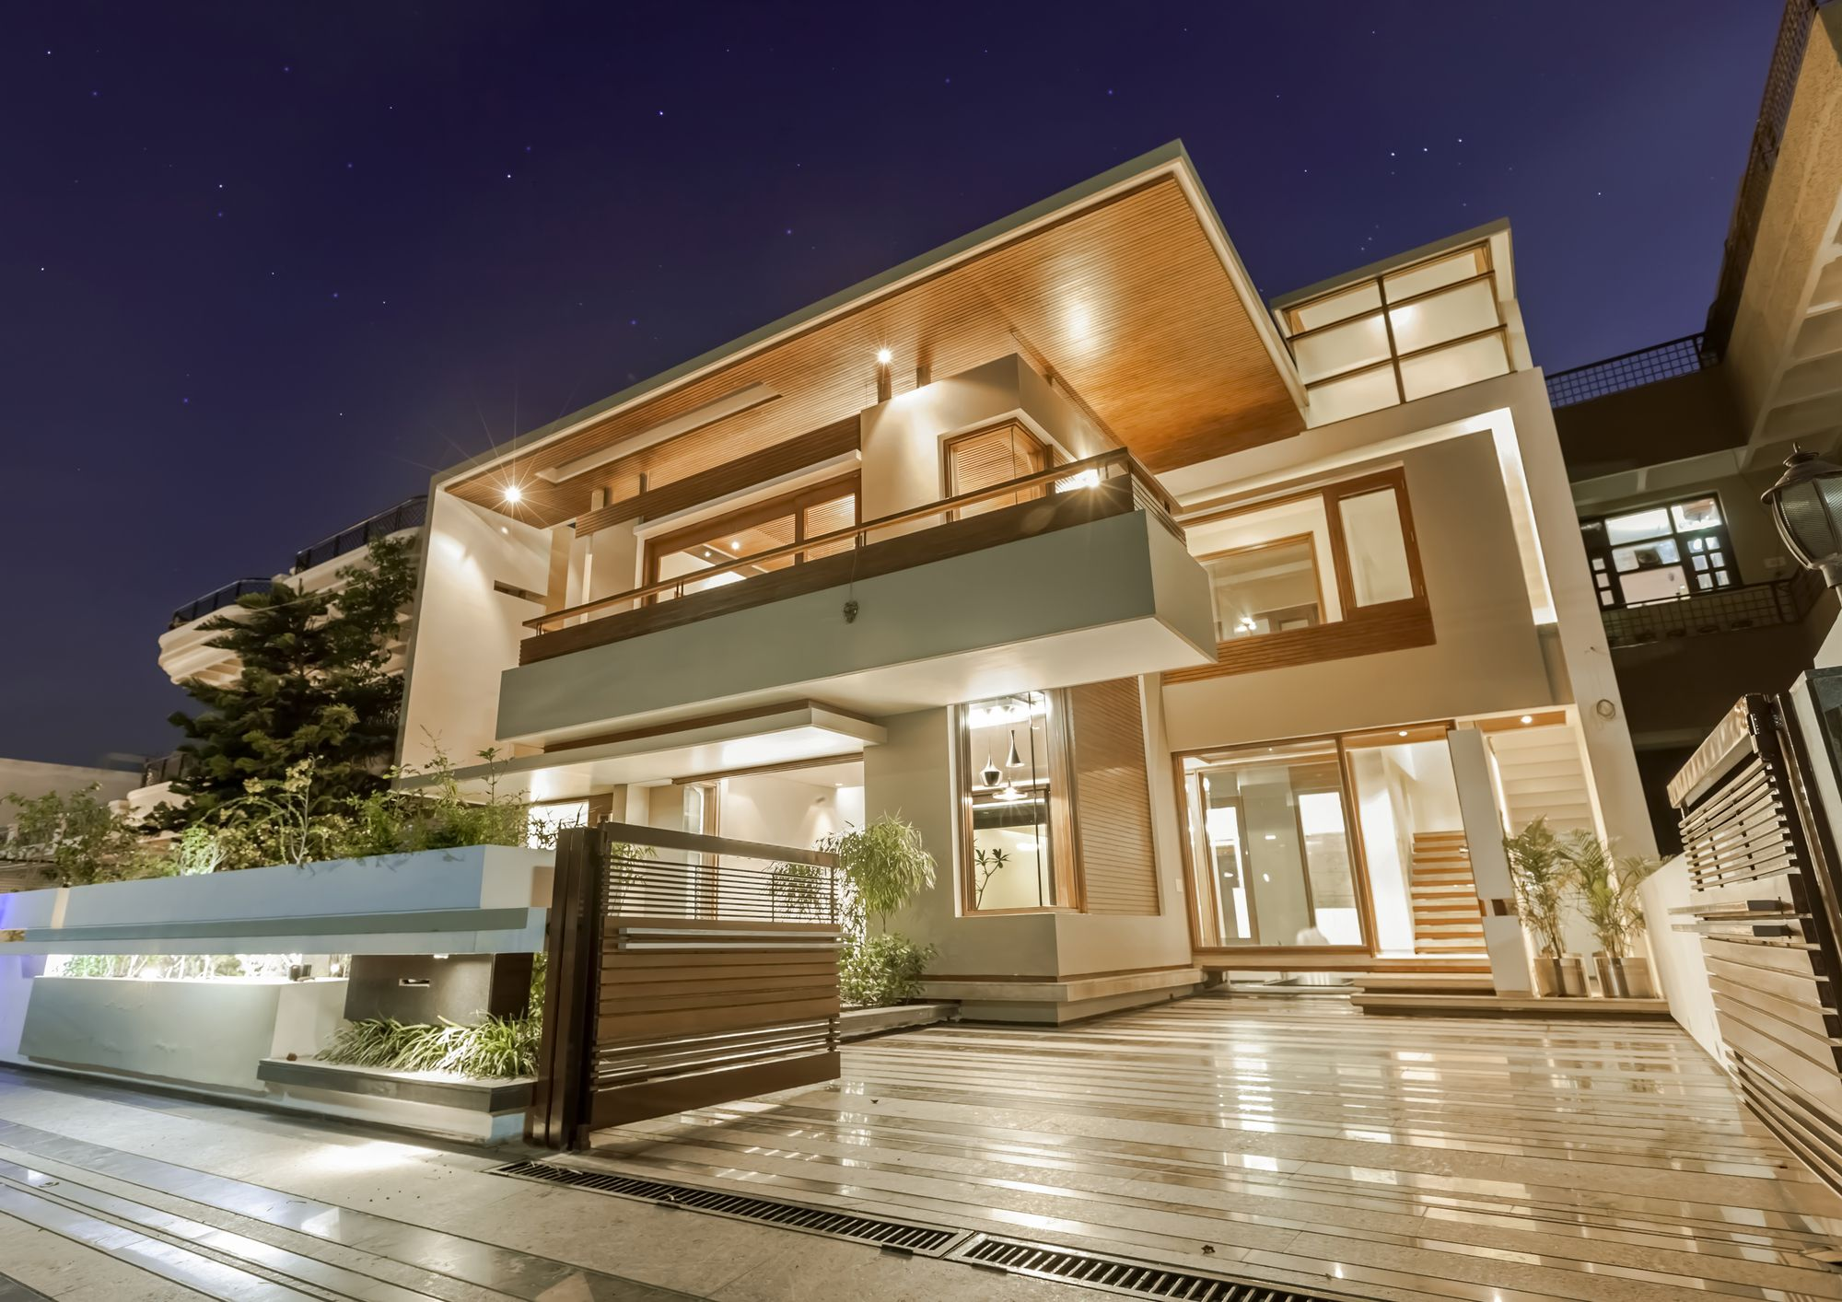

Prediction of House Price
By
Vamsi Krishna
Image Source: https://wallpaperaccess.com/modern-house

Slide 2
Introduction:
The dataset consists of 1460 houses sale information which are built over the period 1872-2010. Characteristics of each house is captured via variables such as, MSZoning, LotArea, Street, Utilities, SaleType, YearSold and many(+75).
Packages:
Language - Python Data Manipulation - Pandas, Numpy Visualisation - Seaborn, Matplot Models - Linear Regression, Decision Tree and Random Forest Cross Validation - Grid SearchCV
AIM:
To create a Machine Learning Model to predict the Sale Price of a house when its characteristics are passed.

Slide 3
1. Count of the Houses Built over the years
Number of houses sold which are built in 2006 are the highest(>60).
Houses Built during the period 1978-1991 are lower than previous years, so do the sales.
268 out of 1460 (18%)houses sold were built during the years: 2003-2007.

Slide 4
2. How many Houses were sold per year?
Nearly 23% houses were sold in 2009 and it is the highest. Lowest number of houses were sold in the year 2010.

Slide 5
3. Variation in Sale Price with change in the Lot Area and MSZoning of the house
The houses of Residential Low zone are spread all over the SalePrice.
SalePrice for most of the houses in Residential Medium zone are in the range: $50,000 - $1,80,000.
The houses above $1,60,000 SalePrice are of Floating Village zone.
Houses above 20,000 sq.ft. Lot Area are of Residential Low Density Zone.

Slide 6
4.1 Understanding the distribution of data for selected columns
All the features are highly skewed. HouseStyle is also skewed but better than other columns.

Slide 7
4.2 Understanding the distribution of data for selected columns
Even here, the features are skewed. Basement Quality is also skewed but better than other columns.

Slide 8
5. Understanding the impact of remodelling on the SalePrice
Density of the houses remodelled after the year 2000 is high. There were very few houses remodelled during 1980-1990.

Slide 9
6. Relation between Sale Price and other features
Outliers are observed in the graphs.
GarageArea and TotalBasementSquareFeet are linearly related to SalePrice.
It is very strange that the SalePrice is low even when the Over All Condition is High.
House condition is negative related with Price.
As the Over all Quality increases, Sale Price increases.
Very few outliers are seen.

Slide 10
7. Which Neighbourhood houses are Expensive?
Houses of the NridgHt Neighbourhood are mostly Expensive.
One exceptional case is, Crawfor neighborhood houses are sold at higher price even though, they are built before 1950.
Most of the houses built after 1950 are sold below $200000.

Slide 11
Data Processing:
There are 11 columns with missing values more than 5%.
And 8 columns which have >80% zeros.
A total of 20 columns(incl. Id) have been dropped.
Data Treatment:
Missing values for Numerical columns are replaced with Mean
And for categorical are replaced with Mode.
Data Transformation:
Categorical data is separated and Label Encoded.
Boolean data is dummy encoded.
All the separated data is merged and then passed to Standard Scalar for transforming the values to single scale.

Slide 12
Splitting Data:
Data is processed with the insights from EDA.
Next, It was split into 75:25 ratio, meaning 75% of Train and 25% of Test.
Models Implementation:
Linear Regression: - Default - Grid SearchCV
Decision Tree Regressor: - Default - Grid SearchCV
Random Forest Regressor: - Default - Grid SearchCV

Slide 13
Evaluation metrics for the Models
RandomForest Regressor gave best results followed by Linear Regression.Grid SearchCV couldn’t help in improving the metrics.

Slide 14
Interpreting Model Coefficients

Slide 15
Tuning the Models
Case-1: Co-efficient values <0.02 and >-0.02
Case-2: Co-efficient values <0.01 and >-0.01
In Case-1, Both the Models are under performing.
In Case-2, Linear Regression model is giving slightly improved results but, RandomForest Regressor results didn't get any better.

Slide 16
Conclusion
From the metrics obtained by performing experiments with different Models, It can be concluded that Linear Regression and Random Forest Regressor are better fit for this data. And, Removing the Columns with coefficient values <0.01 and >-0.01 has shown slight improvements in the Linear Regression metrics.

Slide 17
Future Improvements
Although, Most of the aspects of cleaning, handling, transforming and many... in processing data are covered in this project. There is still room for experiments. Hence, Below are some key points to be considered for future improvements.
Impute missing values(>5%) as well.
Check importance of >80% zero value columns when predicting Sale Price.
Try to reduced the skewness in columns with feature engineering techniques. Ex: Merge lower categories of a column into single category.
Use Random SearchCV while passing data to make the model more generalised.
Try other Regression Models to check for better predictions.

